Slide 1
Balancing innovation and access: Insights from AIM’s Fair Pricing model and its current and future applications
Jocelijn Stokx
Pharmacist at the Belgian Christian Mutuality
Chair of the AIM wg Pharmaceuticals and Medical Devices

Slide 2
Introduction
Access to affordable medicines is essential for equitable healthcare.
Escalating drug prices strain national healthcare systems.
New drug launch prices in the U.S. rose about 20% annually from 2008 to 2021.
Nearly half of new medicines in 2020–2021 had prices above $150.000 (annually).
Solutions: Managed Entry Agreements – International collaborations – Fair Pricing Models.
High costs justified? Evaluation of the Belgian Health Care Knowledge centre (KCE) of the impact of new cancer treatments: no meaningful gains in survival– many uncertainties at the time of market approval.
Notes:
Neyt M, Devos C, Thiry N, Silversmit G, De Gendt C, Van Damme N, et al. Do innovative medicines against cancer always have a real added value? KCE Rep. 2021;(343). https://doi.org/10.57598/R343C.

Slide 3
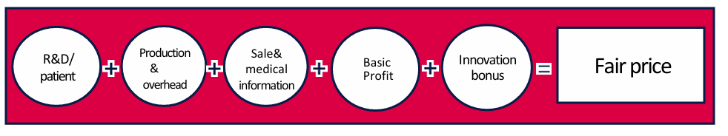
AIM Fair Pricing Model
Developed by the International Association of Mutual Benefit Societies (payers) as a transparent, cost-based alternative.
Price affordable for health systems and patients that rewards true therapeutic value (innovation bonus).

Slide 4
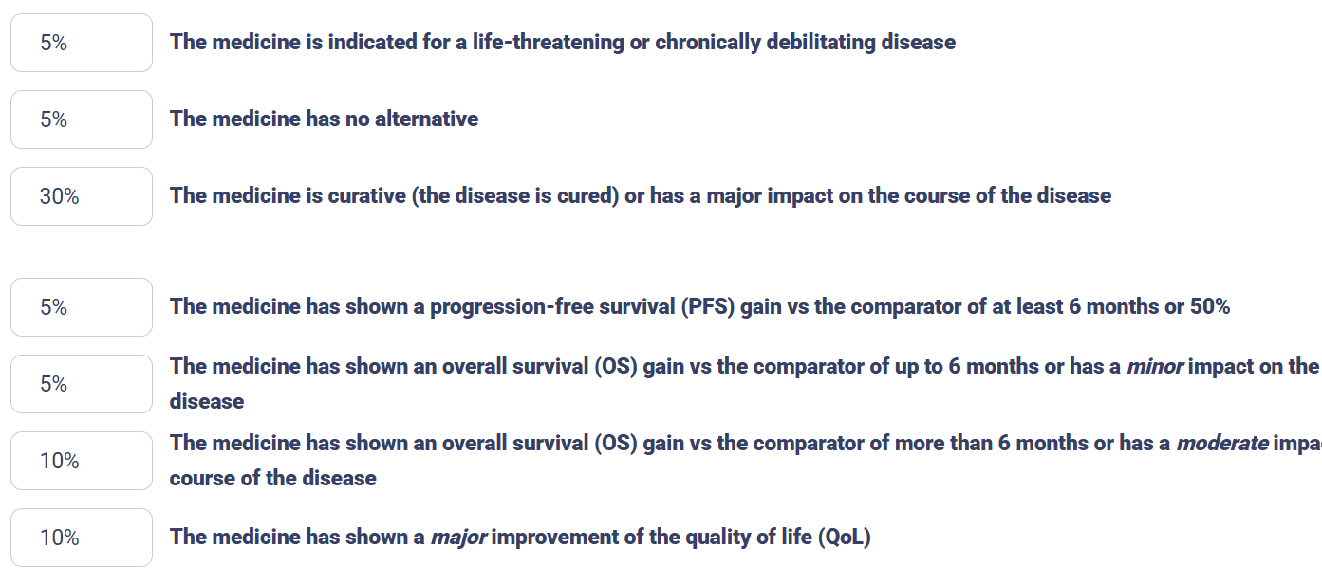
Innovation bonus

Slide 5
Study Objectives
Assess discrepancies between calculated fair prices and actual market prices of new marketed medicines and estimate the potential savings for healthcare systems.
Applied across six European countries: Belgium, Estonia, Germany, the Netherlands, Slovenia, Switzerland.

Slide 6

Methodology
Inclusion of 10 market-protected medicines.
Medicines selected based on:
  Therapeutic diversity: Included treatments for cancer, rare diseases, chronic conditions.
  Budget impact.
  Innovation.
Cancer: daratumumab (Darzalex®), trifluridine with tipiracil (Lonsurf®), palbociclib (Ibrance®).
(Ultra) rare disease: emicizumab (Hemlibra®), selexipag (Uptravi®) and mepolizumab (Nucala®).
Chronic diseases: ocrelizumab (Ocrevus®), glecaprevir with ​pibrentasvir (Maviret®), ​abacavir and ​lamivudine (Triumeq®), semaglutide (Ozempic®).

Slide 7
Methodology (Flow)
Fair Price Calculation: Monthly treatment cost per medicine based on €800M R&D with the AIM Fair Pricing Model.
Actual Costs: Real monthly costs gross and net (estimation if EMA applicable).
Price Gap : Difference between actual market price (gross/net) and fair price.
Estimation of savings: Potential savings calculated per medicine and summed across 10 medicines.
Reduction Rate: Total savings divided by total expenditure on the 10 medicines.
Market Extrapolation: Reduction rate applied to 2020 spending on new patented medicines (from 2015 & 2018).
Scale-Up: Results extrapolated to national and EU levels.

Slide 8
Key findings: fair prices vs actual prices
Fair prices were on average
  53% lower than list prices
  34% lower than estimated net prices
Brand name | Type of disease | Fair Price (R&D 250 mil) per month (€) | Fair Price (R&D 800 mil) per month (€) | Fair Price (R&D 2,5 Bil) per month (€) | Median net prices (€)
Darzalex | Cancer | 861 | 2.384 | 7.089 | 12.703
Uptravi | Ultra-rare | 2.089 | 6.039 | 18.244 | 2.800
Ozempic | Chronic | 34 | 35 | 39 | 76
Nucala | Rare | 950 | 1.092 | 1.532 | 1.004

Slide 9
Key findings: parameters of the AIM fair pricing model
R&D costs
Low impact on price for chronic treatments (E.g. Ozempic).
For 5 medicines, R&D accounts for only 3 to 21% of the price.
Patient population sensitivity: Example, Uptravi. R&D costs of > € 4000 to be recouped monthly per patient.
Innovation bonus
For 4 medicines, bonus is only 5% (never reaches the maximum of 40%).
Production costs
Significant share of price.
For 6 medicines, production costs represent 63- 85% of the total price.

Slide 10

Key Findings: savings
Reduction rates
Gross expenditure: minus 48%-81%.
Net expenditure (countries with available data): minus 37%-74%.
National level savings
Belgium: net savings of € 820 million yearly (total new patented medicines = € 1,2 billion in 2020).
Participating countries
6 countries: Total gross savings of € 9,6 billion.
Belgium, Germany, Estonia and the Netherlands: Total net savings of € 6,2 billion.
European level potential
Annual net savings could reach €27 billion.

Slide 11
Discussion
Savings confirmed by previous Studies (R&D cost of €250 million)
Germany:
Reduction of 63% → €13 billion in savings.
Belgium:
Reduction of 77% → €1 billion in savings.
Rare Diseases
Smaller clinical trial populations: Lower R&D costs -> lower fair price
Limited added value
Low innovation bonusses were attributed, consistent with literature findings.

Slide 12
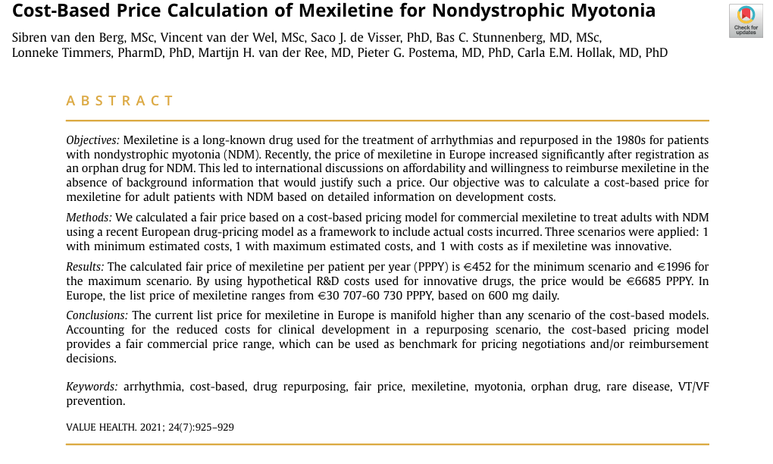
Current Applications
Online calculator (practical tool): Home :: Fair Pricing Calculator.
Model supports price negotiations by Dutch insurers: Petra van Holst, CEO of Zorgverzekeraars Nederland (ZN) “Dutch insurers apply AIM’s fair pricing calculator by default when negotiating drug prices with companies” - AIM mutual.
Integrated into Horizon Europe-funded project ASCERTAIN: ASCERTAIN – IMPROVING ACCESS TO INNOVATIVE HEALTH TECHNOLOGIES.
Can be used for both innovative and
repurposed medicines e.g.:
Cost-Based Price Calculation of Mexiletine
for Nondystrophic Myotonia – ScienceDirect.

Slide 13
AIM Fair Pricing Model in the context of treatment optimisation
Possibility of extra innovation bonus for companies who include optimisation studies in the pre-marketing phase
Post-marketing investment in treatment optimisation can be incorporated in the model to renegotiate pricing and/or achieve a stronger position relative to competitors.
Post-marketing investment in treatment optimisation (de-escalation) brings treatment costs closer to fair prices.
Savings when applying the model could be used by governments to finance treatment optimisation studies.

Slide 14
Conclusion
Current prices are not justified by the underlying costs.
AIM Fair Pricing Model
  Enhances transparency and fairness: potential to strengthen buyer’s negotiation position.
  Safeguards solidarity and sustainability of European health systems.
Calculator is a useful tool for putting the AIM Fair Pricing Model into practice
Fair pricing model can link with treatment optimisation in pre-and post-marketing phase

Slide 15

Contribution to the study
Jocelijn Stokx (BE), Anne Hendrickx (BE), Kärt Veliste (EE), Evelyn Macken (BE), Chiara Brouns (NL), Sandra Scheffler (DE), Goentje-Gesine Schoch (DE), Maja Slapsak (SL), Thomas Kanga-Tona (AIM), Patrick Walter (CH), Sahar Barjesteh van Waalwijk van Doorn-Khosrovani (NL)

Slide 16

Questions

