Slide 1
Collaborative models with academia and research institutions/groups
Denis Lacombe , EORTC Chief Executive Officer

Slide 2
There are many different types of clinical trials and studies that could be shared between the commercial and non-commercial sectors This presentation applies to models of international , multi-centric clinical trials i.e prospective datasets based on robust methodology for treatment related knowledge development /changing practice

Slide 3
Why collaborate?
For industry
Access to specialised network(s)
Access to methodological expertise
Achieving more beyond primary indications
Performing IITs, not handled by CRO
Keeping scientific dialogue open with learned societies
For academia
Access to pipelines of new agents
Contributing to therapeutic progress
Addressing gaps in scientific strategies
Specific interest for specific clinical situations (rare cancers, older patients….)

Slide 4
Are there clinical situations which are more likely to support partnerships?
Extension of label to new tumor types not primarily targeted by industry
Extension to earlier lines of treatment in the same indication
Access to specific networks for recruitment not otherwise easily attainable i.e neuro-oncology, sarcoma.
Access to specific patient populations i.e. Older Adults
Optimisation in patient subgroups: biomarker research
Access to cross-cutting expertise i.e. multi-tumors, radioligands (disease and imaging expertise combined)

Slide 5
Are there types of clinical trials which are more likely to support partnerships?
Complex trials : basket and umbrella
Trials including a QoL/PRO component- Applied QoL research
Registry based clinical trials i.e TwiCs ( if a prospective registry is in place)
Pragmatic clinical trials (for access): methodological and implementation research*
Multidisciplinary clinical trials (radiotherapy, peri-operative trials)
* Defining the role of PCTs in cancer clinical research: outcomes of a collaboration workshop of the EORTC. Lancet oncology 2025

Slide 6
EORTC relevant features (1)
Know-how and reputation
One stop-shop
All functions for a large clinical trial are in-house
Long standing history of successful drug approvals in oncology and of conducting registrational studies
EORTC provides a transparent & honest opinion on trial design, strategy and feasibility, increasing the probability of success of a programme
Peer Review
Methodological relevance
Flexible environment
Large enough to be effective, small enough to be fast
Site contracting and activation
Auditable SOPs and policies
Protocol and database development
Data management and monitoring
Analysis and reporting
Tissue sample collection
Adapting to the evolving interests and needs of partners: industry, HTAs, payors, regulators (EMA/FDA), etc.

Slide 7
EORTC relevant features (2)
Professional project management
Expertise & access to patients
Global trial experience with focus on EU, plus experience in the US and Asia-Pacific
Aggressive timelines are achievable: 4-6 months from final protocol to FPFV is possible
Multidisciplinary organisation
Core expertise in focus areas, such as radiation oncology, elderly patient population, rare cancers, QoL
Integral solutions for complex trials based on translational sciences
Access to different tumour types and equipped with tailored infrastructures (Basket and Umbrella Trials, Trials Within Cohorts.. )
Large international reach
Geared to challenging clinical situations
Access to rare tumors
Competitive cost structure

Slide 8
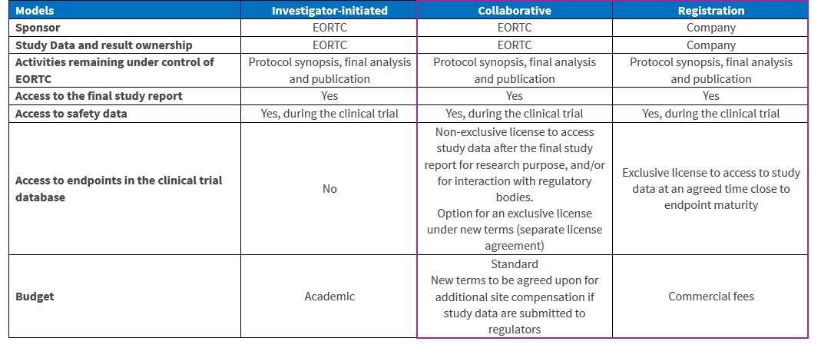
Models of collaboration

Slide 9
Partnerships for collectively re-engineering the process of development and access
how to use therapeutic interventions
Efficacy & therapeutic benefit
Market access
Optimisation
Applied Clinical Research
Health System Optimisation
Health Services & Implementation Research
Pre-clinical research
Regulatory approval
Access / costs
Guidelines
Cancer control plans

Slide 10
Take home messages
Clinical science
Regulatory science
HTA/ Access science
Re-thinking partnerships between the commercial and independent sectors can:
Help optimise the role of stakeholders along side the process of development and access
Build on opportunities for treatment optimisation, addressing research in methodology i.e. PCTs
Thrive the power of independent research for therapeutic progress beyond the primary development agenda
Address patient population not included in regulatory trials i.e. older adults / rare cancers, challenging clinical situations, multidisciplinarity /combination etc…
Contribute to a sustainable economic model for cancer treatment research, development and access.

Slide 11
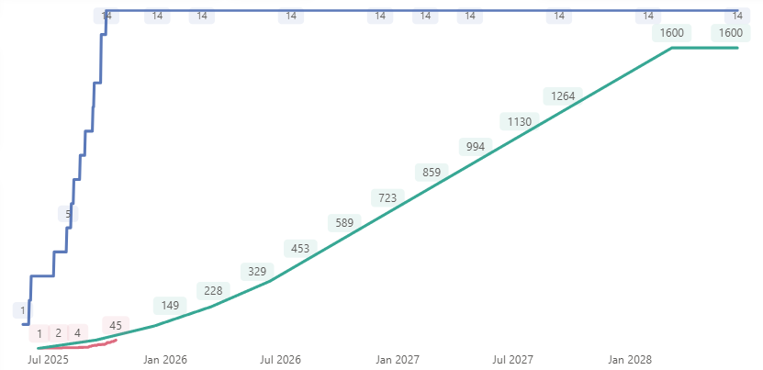
DE-ESCALATE: Intermittent androgen deprivation therapy in the era of new androgen receptor pathway inhibitors
Patients with prostate cancer on ADT+ARPI for 6-12 months who have achieved a significant PSA decline
Continued ADT + ARPI
A Pragmatic IIT
Toxicity and quality of life
R
Intermittent treatment
DE-ESCALATE; Front Oncol. 2024; 14: 1391825

Slide 12
Why EORTC has stimulated the CMF?
Many questions remain unaddressed at the time of MA
Increased challenges to run CT with optimisation intent (dose, combination, sequence, schedules, patient subgroups (i.e OA), who does/does not benefit…)
Discuss the regulatory acceptability for specific methodology i.e. pragmatic trials
Though optimisation is a continuum, many questions remain in the post licensing space: balance between access to innovation and the use of innovation
Address the uptake of the work of the non-commercial sector in the regulatory and access process to therapeutic interventions
Support the development of EU cancer policies taking into account the full environment and the entirety of the data which can be generated.

