Slide 1
CTIS Bitesize Talk: Training materials, CTIS pre-requisites, and updates on transparency rules
29 November 2023
Presented by Francesca Scotti and Ornela Ademi Data Analytics and Methods Taskforce (EMA)

Slide 2

A few housekeeping rules
Questions were collected in advance on www.sli.do
With event code #bt29nov
Tips for optimal screen viewing
Make use of the instructions under the Live broadcast section on the event page and connect directly to the EMA's Vimeo channel 1 for the full-screen experience
Have a stable internet connection

Slide 3
Agenda
CTIS Training materials and prerequisites
Revised CTIS transparency rules
Q&A session

Slide 4




CTIS Bitesize Talk - Panellists
Ornela Ademi
CTIS Change Manager
Francesca Scotti Scientific Specialist

Slide 5
CTIS Training materials and pre-requisites
Where to start with CTIS?
Presented by Ornela Ademi
Change Manager
Data Analytics and Methods Taskforce (EMA)

Slide 6
Pre – requisites: Where to start?
Actions prior to using CTIS
EMA account - any CTIS user needs to have an EMA account
Sponsor organisation is registered in OMS - Log in to OMS with your EMA account
Sponsor Administrator is registered in IAM – request the first Sponsor Administrator role in EMA Account Management
Sponsor organisation to register with EudraVigilance (via Gateway or EudraVigilance (EV) web application (EVWEB)). More information on how to register with EudraVigilance is available here.
Refer to 'Who needs to report what' on EudraVigilance: electronic reporting to find out whether to register for safety reporting, product reporting or both.
Requisites for registration for commercial/non-commercial sponsors: EudraVigilance registration documents (europa.eu)
For EudraVigilance access, users should log into the EMA Account Management portal and request a 'EudraVigilance role'. For more details, see the Registration manual.

Slide 7
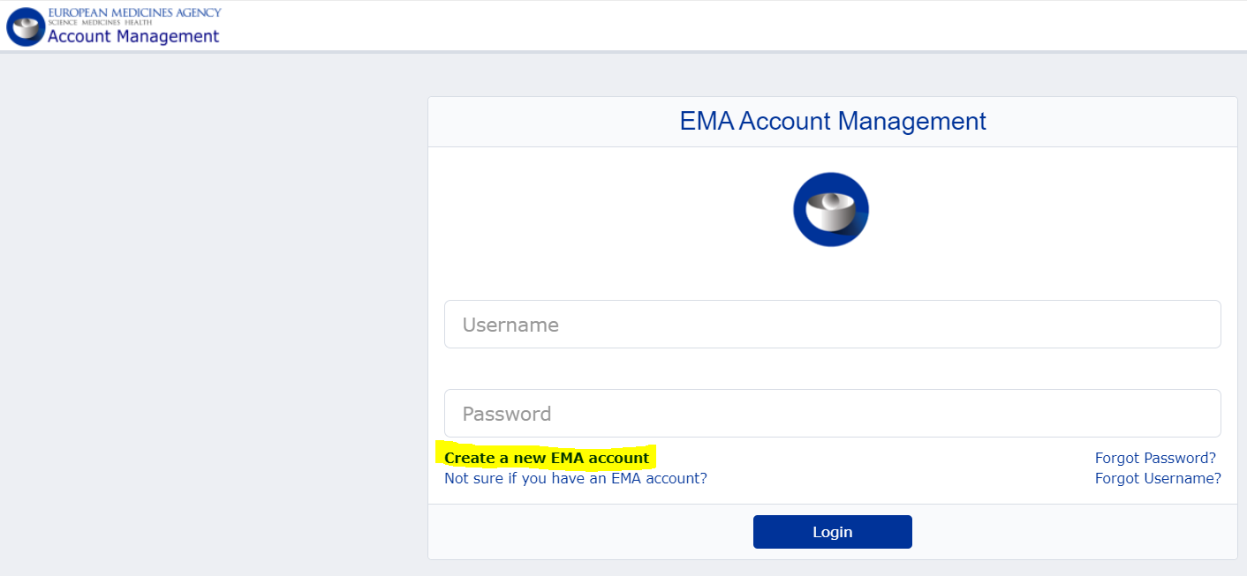
EMA account

Slide 8
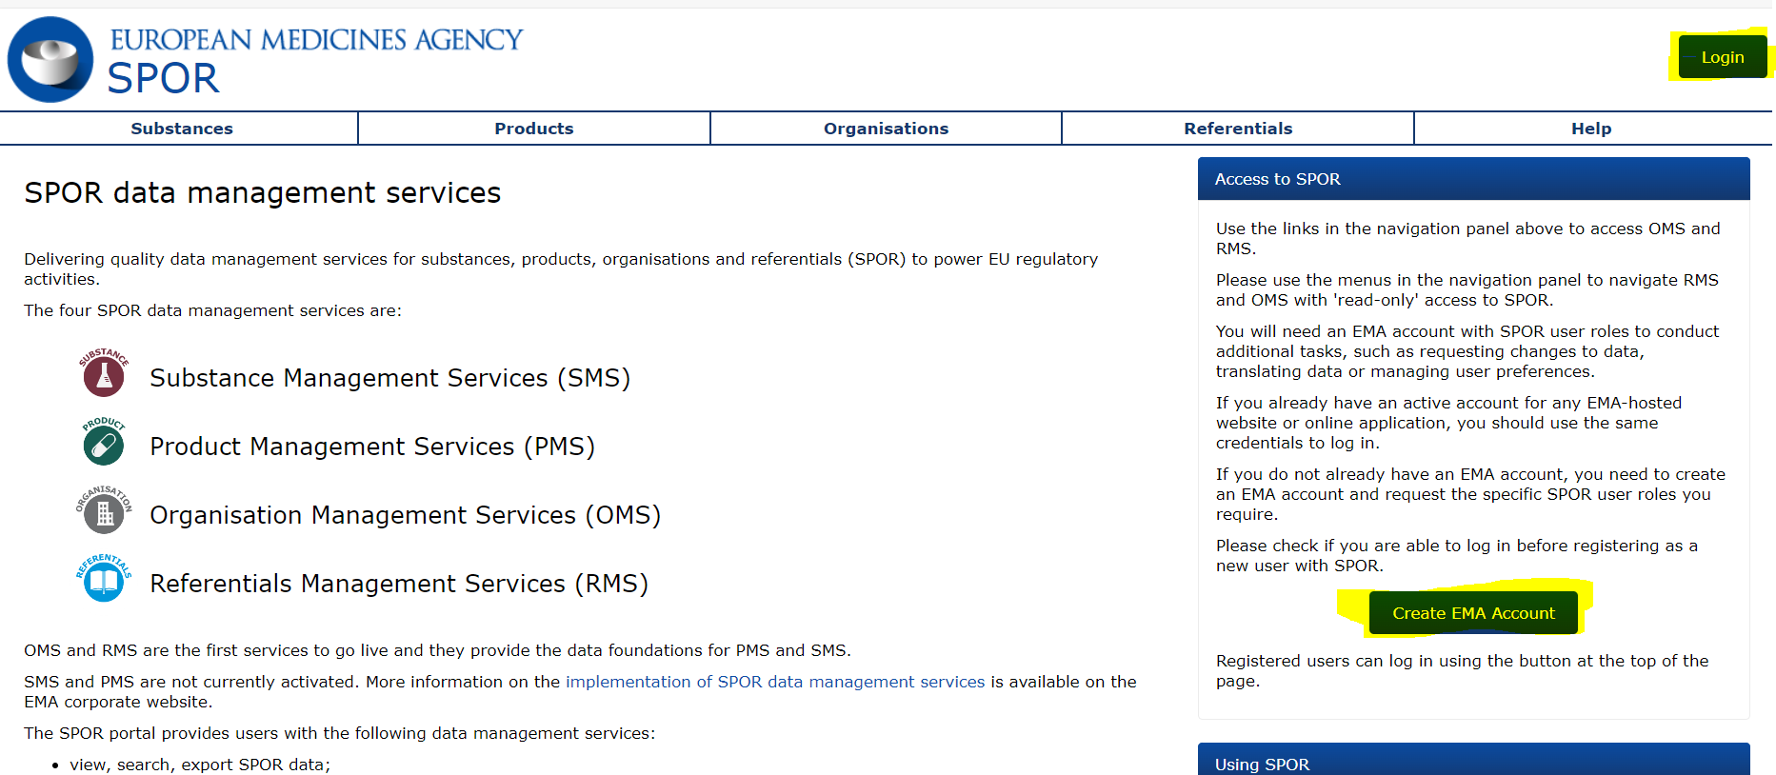
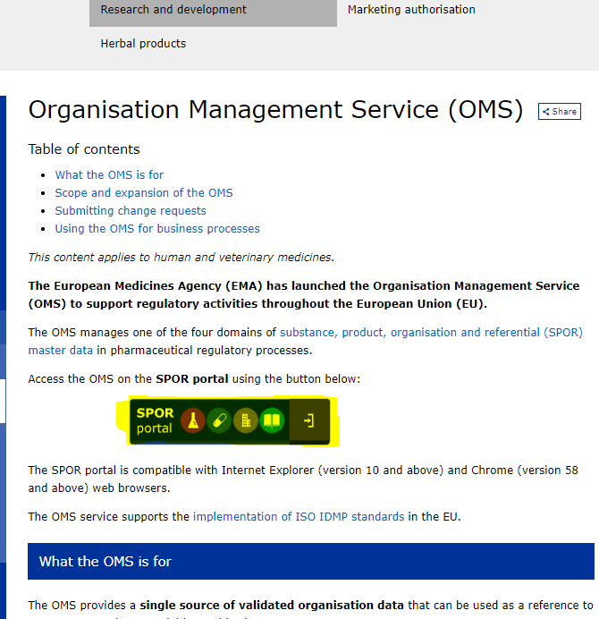
OMS

Slide 9
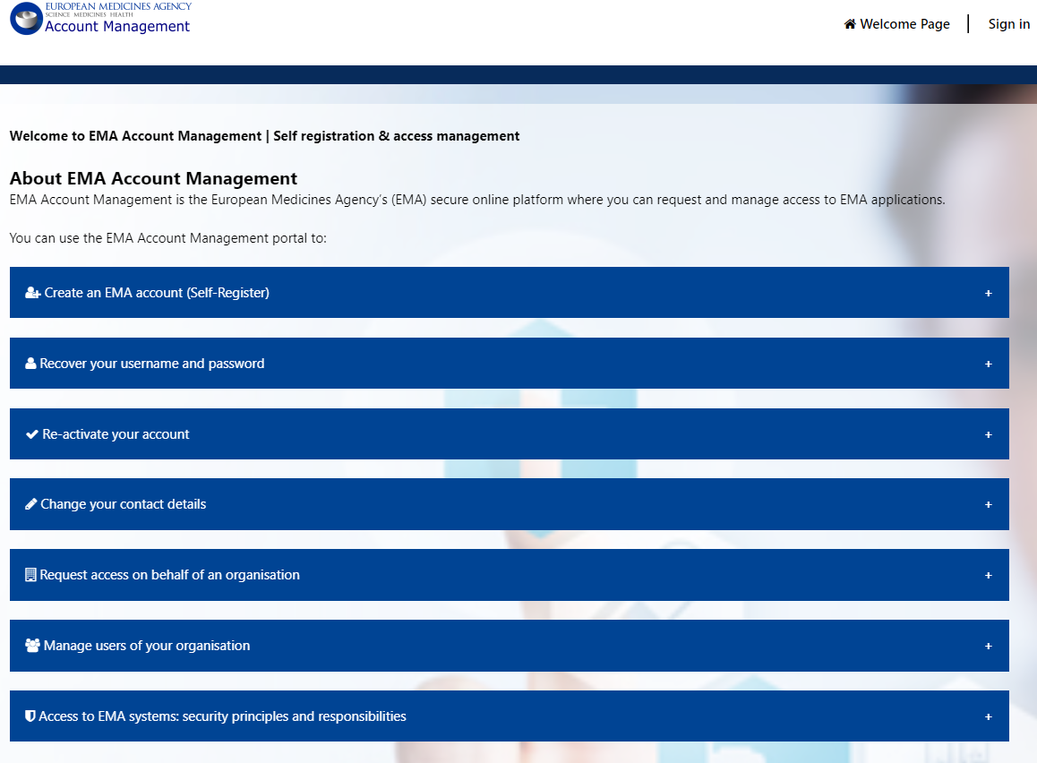
EMA Account Management

Slide 10
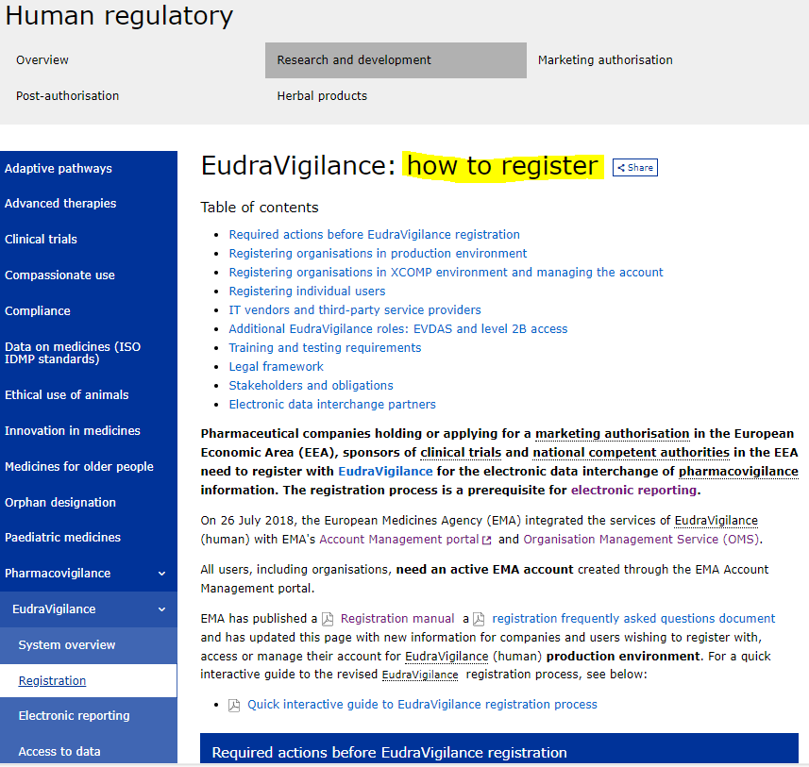
Register with EudraVigilance

Slide 11
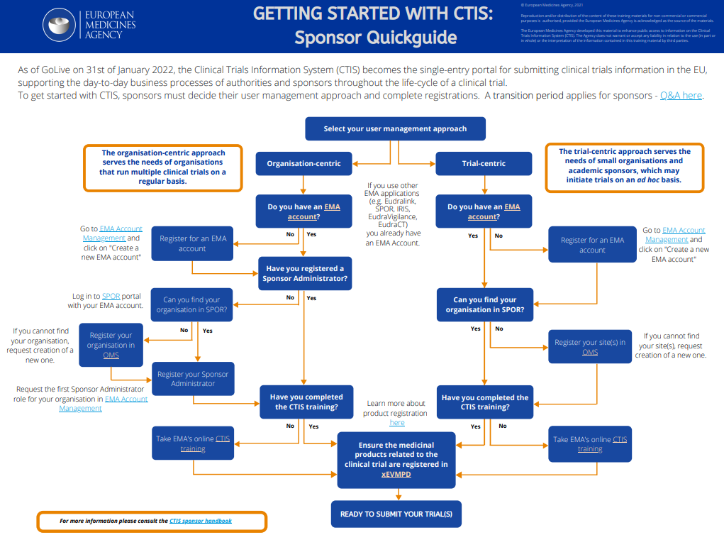
Getting started with CTIS - Sponsor quick guide (europa.eu)

Slide 12
General useful information for sponsors
Online modular training
Overview of the different modules of Online Training: Guidance to CTIS training material catalogue
Module 02 (Online modular training): High-level overview of CTIS workspaces and common system functionalities
Sponsor handbook
CTR Q&A published by the European Commission under EudraLex volume 10

Slide 13
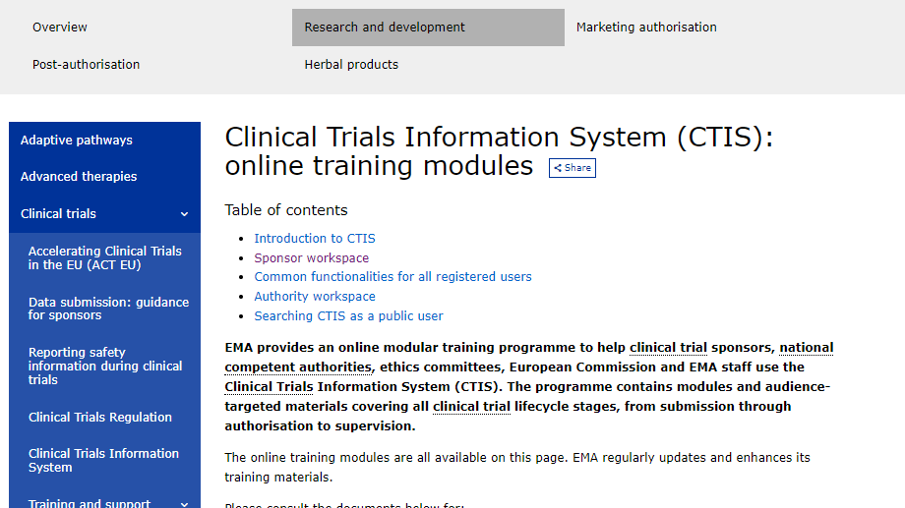
Online modular training

Slide 14
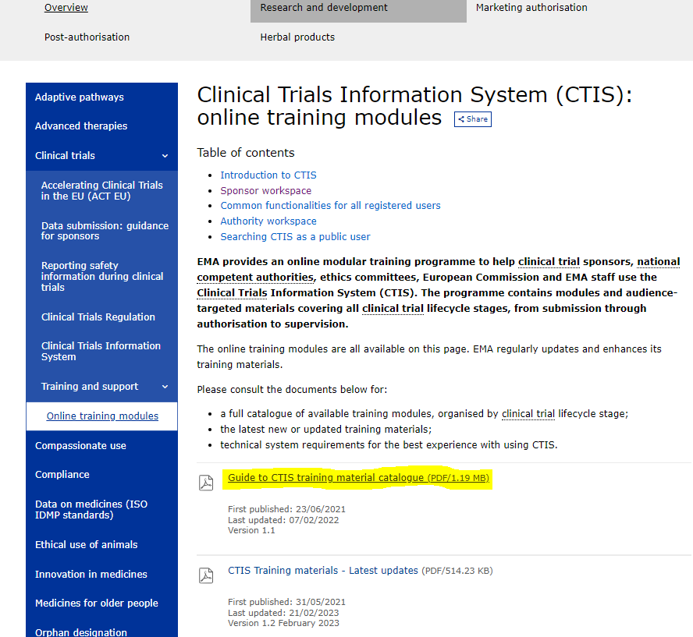
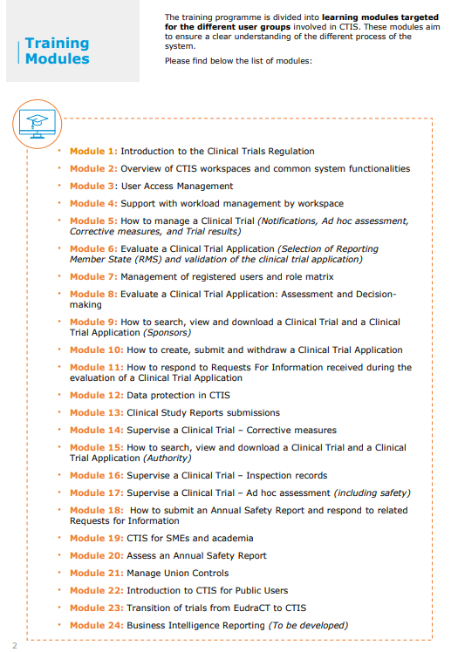
Guidance to CTIS training material catalogue

Slide 15
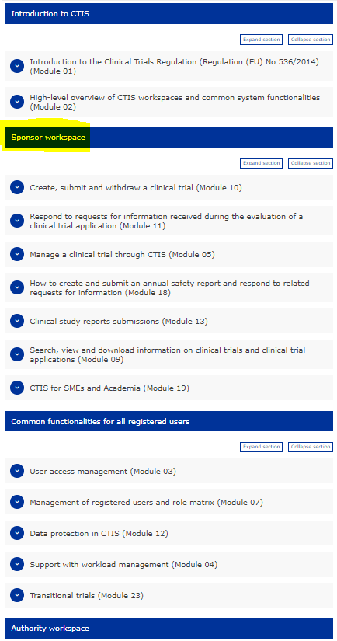
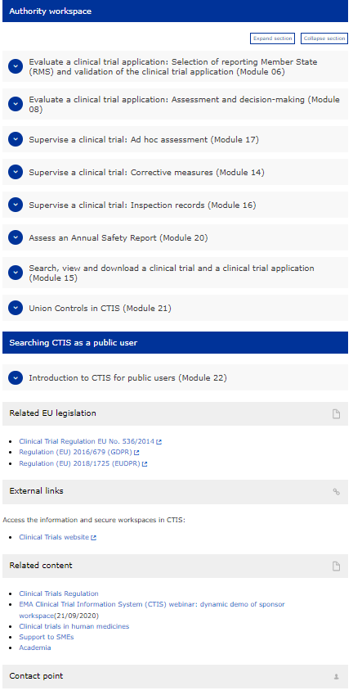
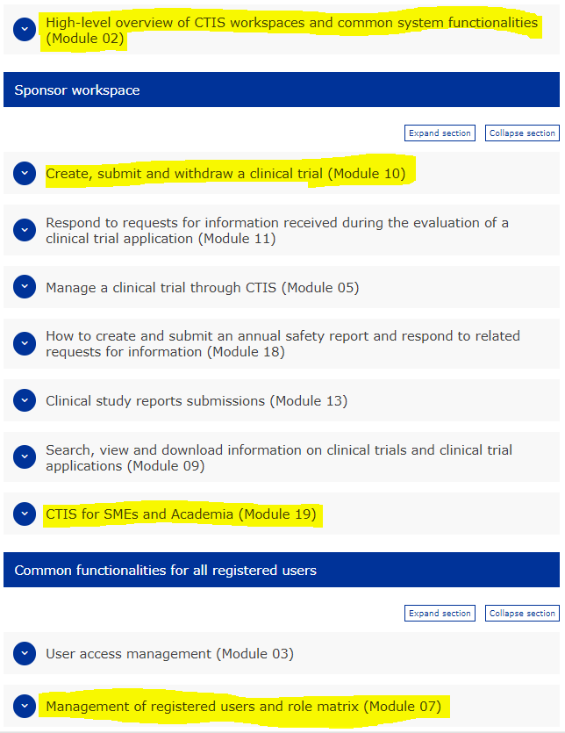

Slide 16
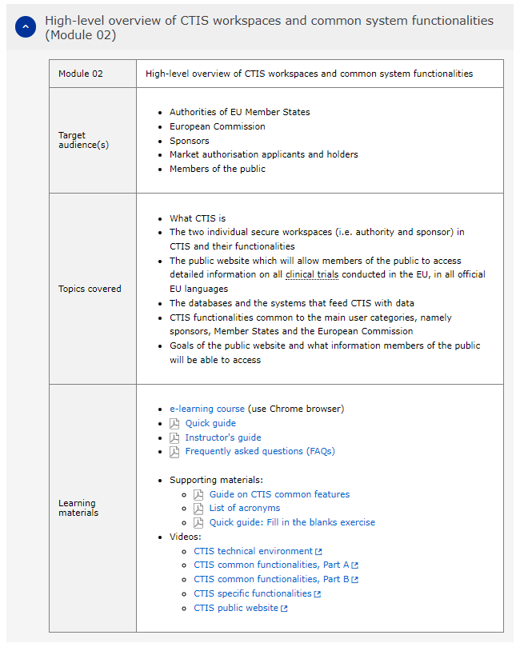
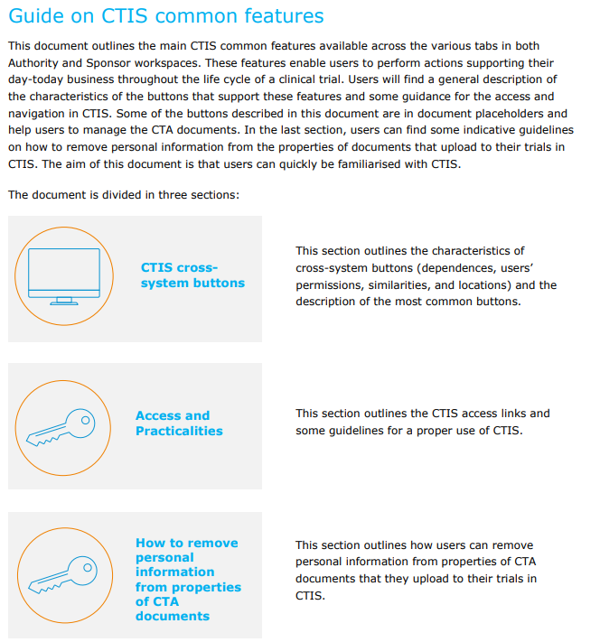
Module 02: Online modular training

Slide 17
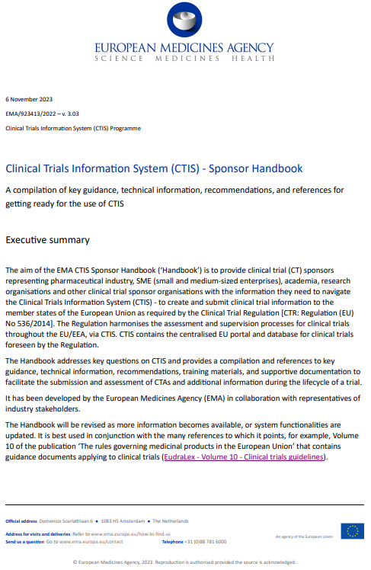
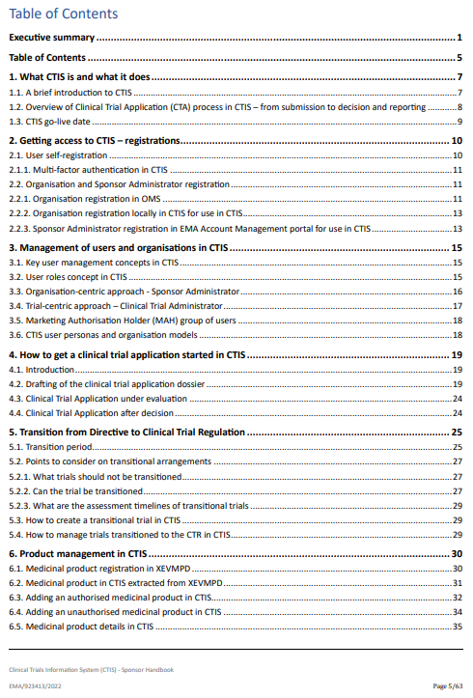
Sponsor handbook

Slide 18
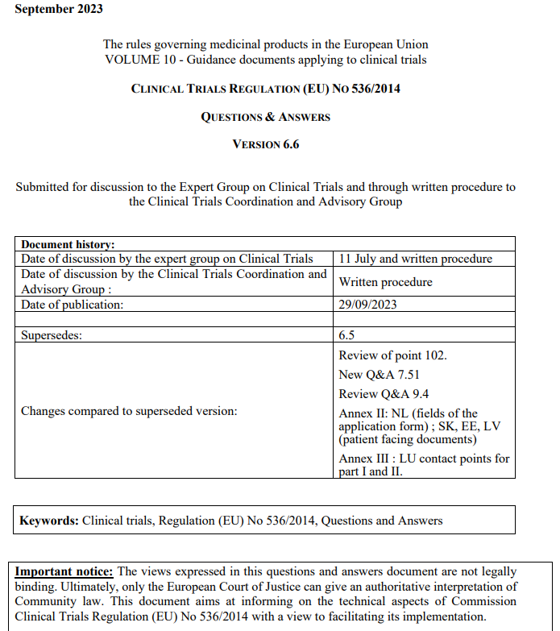
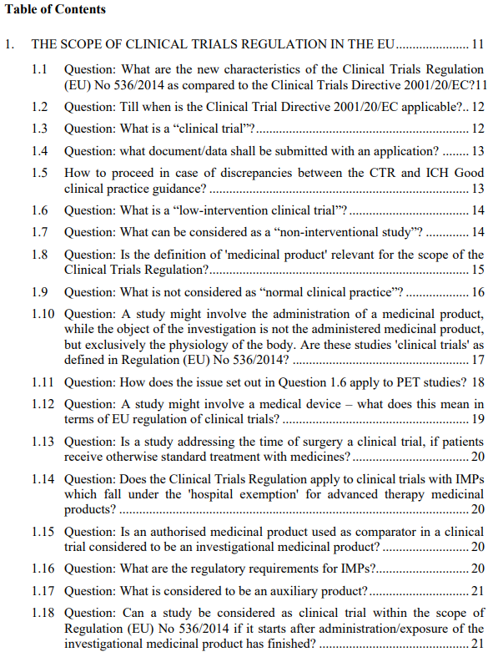
CTR Q&A

Slide 19
Guidance & information on creation of new CTA
Module 10 (Online Modular training): Create, submit, and withdraw a clinical trial
e-learning course: initial clinical trial applications (use Chrome browser)
e-learning course: other types of clinical trial applications (use Chrome browser)
Step-by-step guide
Instructor's guide
Frequently asked questions (FAQs)
Supporting materials:
Process puzzle
Checklist of required fields per application type

Slide 20
Live demos on creation of new CTA
Bite size talk:
Initial clinical trial application (including presentation)
Videos:
How to submit an initial clinical trial application in CTIS – Fill in the Form and the MSC sections How to submit an initial clinical trial application in CTIS Sponsor workspace – Fill in the Part I section
How to submit an initial clinical trial application in CTIS – Fill in the trial details of Part I section
How to submit an initial clinical trial application in CTIS – Fill in the Sponsor details of Part I section
How to submit an initial clinical trial application in CTIS – Fill in the Product details of Part I section
How to submit an initial clinical trial application in CTIS – Fill in the Part II section
How to submit a substantial modification in the CTIS Sponsor workspace
How to submit an additional Member State concerned application in the CTIS Sponsor workspace

Slide 21
Registered uses and role matrix
Module 07 (Online Modular training): Management of registered users and role matrix
Clinical Trial centric approach vs organisation centric approach
How to request roles and how to assign roles to register users in CTIS
Module 19 (Online Modular training): CTIS for SMEs and Academia
Quick guide - Introduction
Step-by-step guide: User administration

Slide 22
Information on Transitional trials
Module 23 of the CTIS online training programme
Bitesize talk: How to submit a transitional trial in CTIS (including presentation)
Bitesize talk: Transitional trials and additional Member State concerned (MSC) application (including presentation)
Guidance for the transition of clinical trials published by the European Commission under EudraLex volume 10
CTCG’s best practice guide & cover letter template for sponsors of transitional trials
Important to remember that sponsor should raise a ticket with the CTIS User Support Service if sponsor cannot find the trial, they wish to transition in CTIS when searching by EudraCT number.

Slide 23
Thank you for your attention

Slide 24
Revised CTIS transparency rules
Presented by Francesca Scotti
Scientific Specialist
Data Analytics and Methods Taskforce (EMA)

Slide 25
Table of contents
Legal basis, current rules and adoption of revised rules
Publication of structured data as per revised CTIS transparency rules
Publication of documents as per revised CTIS transparency rules
Implementation
ACT EU_Q&A on protection of CCI and PD: Interim period & Historical trials
Benefits for stakeholders

Slide 26
Legal basis, current rules and adoption of revised rules

Slide 27
Article 81(4) of Regulation (EU) No. 536/2014
Transparency in the Clinical Trials Regulation
Transparency is a pillar of the CT Regulation, delivered through the searchable Clinical Trial Information System (CTIS) public website
EU database publicly accessible by default, with exceptions justified on any of the following grounds:
– Protection of personal data;
– Protection of commercially confidential information in particular taking into account the MA status of the medicinal product, unless there is an overriding public interest in disclosure;
– Protecting confidential communication between MS in relation to the preparation of the assessment report;
– Ensuring effective supervision of the conduct of a clinical trial by MSs.
Current CTIS transparency rules defined in the Appendix on disclosure rules

Slide 28
Current CTIS transparency rules
Current rules defined in the Appendix on disclosure rules:
Broad publication of documents and structured information of the clinical trial application (CTA) dossier submitted in CTIS during the CT life cycle
Deferral mechanisms (up to 7-years after end of trial) to protect commercially confidential information (CCI)* considering applicable clinical trials categories OR Redaction of CCI in the document version ‘for publication’
However, since CTIS go live, those rules:
have proved to be complex to apply in practice (numerous docs to be redacted by sponsors)
have raised concerns about the timing for the publication of key documents (protocols could be published up to 7 years from end of trial)
Public consultation occurred in May/June 2023, feedback from CTIS stakeholders: consensus on the need for simplification
* Redaction of personal data is always applicable, and regardless of the use of deferrals

Slide 29
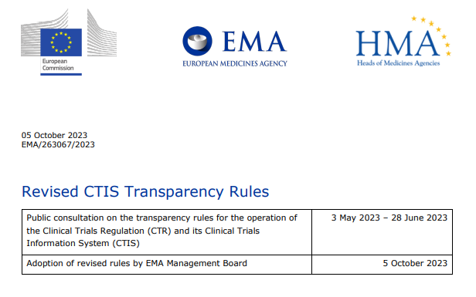
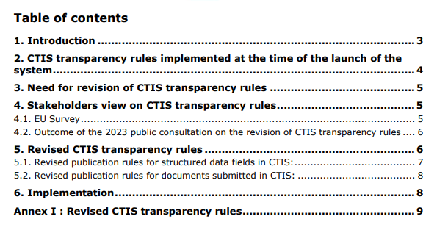
Revised CTIS transparency rules adopted on 5/10/2023
The underlying principles of the revised CTIS transparency rules are based on the results of the public consultation: increase simplification and clarity, while reducing burden for CTIS users
Main differences compared to current publication rules:
publication focused on key documents of interest
removal of deferral functionality – documents are published earlier in time
use of redaction as the method to protect CCI and personal data, if included in those key documents
Applicability: applications submitted as of launch of new public website

Slide 30
Publication of structured data
As per revised CTIS transparency rules, applicable to all applications submitted as of launch of new public website

Slide 31
Structured data – what will be published & when
Structured data | Category 1 |  | Category 2 integrated ph1&2 | Category 2 & 3 (excl. integr. ph1&2)
Structured data | Paediatrics and/or PIP | Adults
CTA fields* | First MSC decision | First MSC decision | First MSC decision | First MSC decision
 |  | 30 months after EU/EEA End of Trial
Product/AS details on strength, dose and treatment duration* | 30 months after EU/EEA End of Trial
MSC(s) conclusions and decision outcomes | That MSC decision |  | That MSC decision
Notifications on trial status and recruitment | As soon as submitted by sponsor
Notifications on serious breaches, urgent safety measures, unexpected events | After MSC assessment | 30 months after EU/EEA End of Trial & MSC assessment | After MSC assessment | After MSC assessment
Corrective measures (suspension, revocation, modification request) | When applied by MSC(s)
*see following slide

Slide 32
Structured data – what will be published & when
Structured data | Category 1 |  | Category 2 integrated ph1&2
Structured data | Paediatrics and/or PIP | Adults | Category 2 integrated ph1&2
CTA fields populated by the sponsor, including: Public title (= title in lay terms) Trial identifiers in registers, protocol code Phase, medical cond., rare disease, therap. area Population age, gender Sponsor details Details of clinical investigator sites in MSC(s) | First MSC decision | First MSC decision | First MSC decision
Remaining CTA fields populated by the sponsor |  | 30 months after EU/EEA End of Trial
Product/AS details: Product & active substance strength, Maximum duration of treatment, Maximum daily dose allowed, Daily dose unit of measure, Maximum total dose allowed, Total dose unit of measure | 30 months after EU/EEA End of Trial

Slide 33
Structured data – what will be published & when
Structured data | All categories
Sponsor legal representative details | Never
Any request for information (RFI) and RFI responses | Time of decision of first MSC
Validation conclusion details, assessment decision conditions (if any)
MSC(s) assessment(s) on notifications
3rd country inspection details

Slide 34
Publication of documents
As per revised CTIS transparency rules, applicable to all applications submitted as of launch of new public website

Slide 35
Documents – what will be published & when
 | Category 1 |  | Category 2 and 3 including integrated ph1&2
Documents type | Paediatrics and/or PIP | Adults
Protocol, synopsis, patients facing documents | Upon results’ submission | 30 months after EU/EEA End of Trial | First MSC decision
SmPC, if available | Never |  | Time of decision of first MSC
Subject information and informed consent form |  |  | That MSC decision
Recruitment arrangements, including procedures for inclusion and copy of advertising material |  |  | Time of decision of first MSC
Final summary of results, Lay person summary of results | As soon as submitted | 30 months after EU/EEA End of Trial | As soon as submitted
Clinical study report, if available | As soon as submitted
All other documents, including any MS document | Never

Slide 36
Implementation

Slide 37
Implementation
Development of a revamped CTIS public portal
Q4 2023 – Q2 2024
01
Launch of revamped CTIS public portal & application of revised transparency rules
2024
02

Slide 38
Interim period & Historical trials
Section 4 of ACT EU Q&A on the protection of Commercially Confidential Information and Personal Data while using CTIS

Slide 39
Interim period: until the new CTIS public website is launched
For initial applications:
sponsors may provide the version ‘for publication’ only for those documents in scope of the revised rules, and for those documents that will no longer be subject to publication, upload in the slot ‘for publication’ a page with wording suggested in Annex I*
the above should translate in refraining from requesting deferral, as CCI are protected by redaction in the documents in scope of publication
For modifications/additional MS applications: sponsors should consider the preferred approach on protection of personal data and CCI, with the aim to decrease burden depending on the status of the trial, i.e. whether deferrals are already in place
For transition trial applications: sponsors should follow the principles of Q 11 of the Guidance for the Transition of clinical trials from the CTD to the CTR and submit a redacted version ‘for publication’ only of protocol, subject information sheet and ICF
*Annex 1 of the ACT EU Q&A on the protection of Commercially Confidential Information and Personal Data while using CTIS

Slide 40
Historical trials: submitted before the new CTIS public website is launched
For all those trials submitted to CTIS prior to the technical implementation of the revised rules on CTIS public website, as of new CTIS public site go-live date:
the structured data will be published for all trials’ categories as per revised rules
documents will not be published: publication of documents in scope of the revised rules will occur only when included in applications submitted after the revised rules are in place (this applies to all historical trials, regardless of the previous use of deferrals or publication status)
Example: phase II trial with deferral on protocol, initial application submitted before technical implementation of revised rules in the CTIS website:
Structured data published at the date of go live of new CTIS public website
Documents of initial application not published on new CTIS public website
SM-1 submitted 1 month after go live of new CTIS public website with the purpose of updating the IB: protocol and synopsis will be subject to publication as per revised rules
→ for applications submitted in CTIS after the launch of the new Public Portal the documents in scope of publication will be published and should be redacted accordingly

Slide 41
Benefits for stakeholders

Slide 42
Patients, HCP
Benefits for stakeholders
Less documents requiring redaction of CCI and personal data → reduced complexity and faster preparation of CTA dossier
Removal of the deferral mechanism delivers significant process simplification and reduces the risk of inadvertent publication of CCI
Simpler and earlier publication increases patients’ engagement and trust
Sponsors
Thanks to removing deferral functionality, patients can access key data and documents as early as possible in the clinical trial lifecycle, before the start of the trial
Focus on publication of key clinical trial information (incl. protocols) → patients able to easily identify published information of interest by reduced complexity
Earlier access to information for patients will facilitate the start of trial and enrolment
Increased awareness on possible treatment options

Slide 43
Thank you for your attention

Slide 44

CTIS Training Environment update
The CTIS Training environment survey (Survey 4.0) is reopened:
https://ec.europa.eu/eusurvey/runner/2abb5ba8-0ec4-9979-b692-0c63f4508b9b
This survey collects expressions of interest in accessing the CTIS training environment, information and contact details of representative individuals, the organisations that they represent and the planning for use of CTIS of these organisations is reopened.
All details will serve to proactively identify the needs and intentions of use of CTIS and grant access accordingly.

Slide 45

Upcoming CTIS events
13 Dec 2023, 16:00 – 17:00 CET – CTIS Walk-in Clinic
For 2024 CTIS events, please consult Clinical Trials Information System: training and support | European Medicines Agency (europa.eu) and EMA events pages

Slide 46


Thank you for attending today’s event
Please provide your feedback for this event in our Slido survey Use the passcode: #bt29nov or scan the QR code
Further information
For the CTIS Newsletter sign up at https://ec.europa.eu/newsroom/ema/user-subscriptions/3201/create
For upcoming CTIS events visit the EMA event page.
Official address Domenico Scarlattilaan 6 ● 1083 HS Amsterdam ● The Netherlands
Telephone +31 (0)88 781 6000
Follow us on @EMA_News
Notes:
Note: This slide is OPTIONAL. It uses the 'Closing slide' layout. Delete if not needed.

