Slide 1
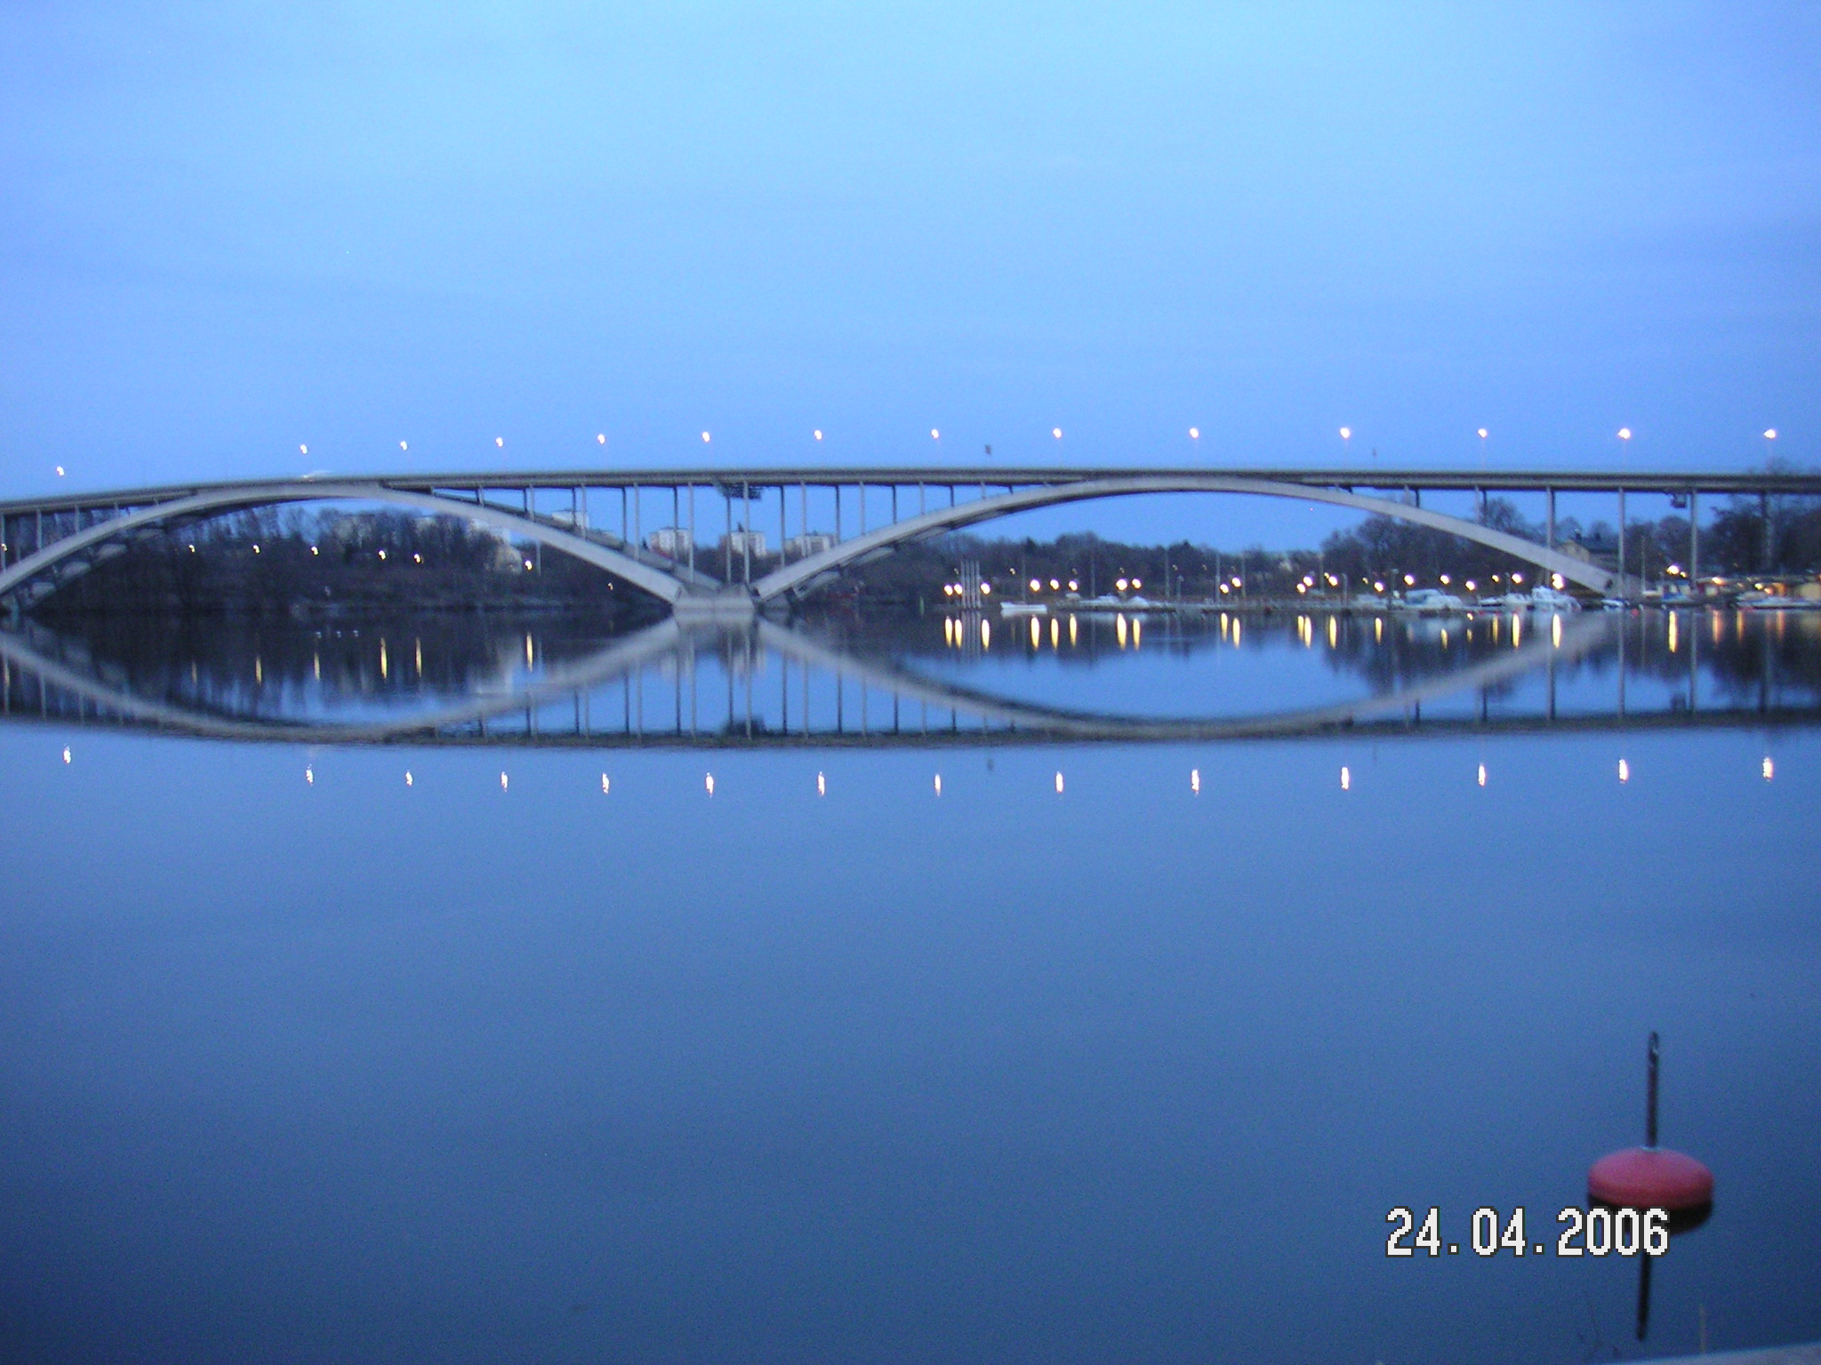


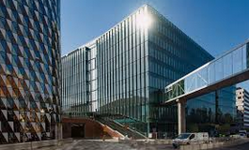
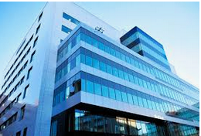
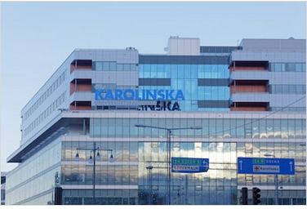
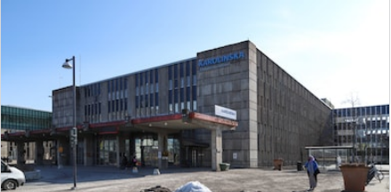
Jonas Bergh M.D., Ph.D., FRCP (London, UK)
Professor of Oncology, Karolinska Institutet, Co-Chair EBCTCG,
Visiting Professor, Oxford University,Cancer Research Karolinska Institutet and Karolinska Comprehensive Cancer Center (KCCC)
Senior Consultant in Oncology, Breast Cancer Center, KCCC
Board Member Karolinska CCC, Stockholm/Solna, Sweden
Visiting address: Bioclinicum, J 5:30, Visionsgatan 4,
Opportunities in sharing molecular clinical data
EMA is to be congratulated for today´s meeting and initiative

Slide 2
Development - changing landscape
Innovations and early development by pharma industry have been corner stones for the access to novel, many times innovative cancer medicines, during the last decades- reflecting the better understanding of cancer at a molecular level, rational drug designs, resulting in improved outcomes- at best -decreased cancer specific mortality
Have together with academic groups and the pharma industry been involved in phase 1-3+ studies since some 30+ years
EMA SAG member (2004-2021/22), acting head SAG oncology-hematology the last five years (Acted as Chairperson during EMA´s 25-year celebration a few years back). On single occasions worked as an advisor to FDA

Slide 3
Development - changing landscape
The collaborations have involved work with the Scandinavian Breast Group, the Swedish Breast Cancer Group, EORTC, BIG etc., as well as interactions with EMA, FDA and US intergroups.
These collaborations have of course for decades involved investigator initiated clinical studies, with support from- collaborations with different pharma industries.

Slide 4
Academic investigators have observed that the academic influence / the number of such studies have quite dramatically diminished during the last years being a serious concern.
The industry seems less interested in running collaborative studies, with strong influences from the academia. “Contral is important”.
Some (“companies”) see this as a positive development – others are more concerned – worried- the translational science may risk to be more superficial- investigating / understanding mechanisms for effects/side-effects may not be given priority.

Slide 5
How to proceed – some thoughts
“Conditional marketing authorisation
The European Medicines Agency (EMA) supports the development of medicines that address unmet medical needs. In the interest of public health, applicants may be granted a conditional marketing authorisation for such medicines on less comprehensive clinical data than normally required, where the benefit of immediate availability of the medicine outweighs the risk inherent in the fact that additional data are still required.” Just passing the approval process or with margin trying to understand / explore the tumour biology- which potentially may enhance the benefit-risk balance ?
How should the additional data be obtained?
Patients have the ownership of their blood and tissues/cancers. These individuals should be much more involved.
“Primary approval” – issues – e.g. pCR for breast cancer is a strong prognostic factor after neoadjuvant therapy, other factors need to be explored - How extensive should the initial approval process be??
Is additional therapies post pCR needed ?- Of particular importance in the light of the presence serious side-effects and health economical costs.

Slide 6
Additional data required for full market authorisation
Presently: EMA and the Market Authorisation Holder (MAH)
Who else should be involved: “Patients have the ownership of their blood and tissues/cancers” should be involved.
“Academia” and “payers” should also be important
MAHs are (very) good to fulfil the requirement by EMA and FDA.. Based on the present rules/guidelines/legislation…
Advanced and frontline strategies with the most advanced “multi-omics” may not be used- thereby potentially missing options to even better analyse the benefit-risk balance

Slide 7
Opportunities in sharing molecular clinical data
How to understand interpatient differences in the anti-cancer effects and side-effect profiles, albeit the overall benefit-risk balance may be positive…the heterogeneities are not captured, characterized and studied.
Liquid biopsies: whether such studies reflect the totalities in the cancer/stromal cells compartment- is so far not known (?) What can be measured in the circulation vs biopsy-based studies?
“Multiomics” and SNP profiles need to be applied on the relevant tissues (normal cells and cancer cells and in the circulation).
The “Academia” are well suited to explore these avenues, but are nowadays rarely involved in building the registration dossiers…
Is that an optimal development for the patient and societies?

Slide 8
Relevant biobanked materials should be used more and findings correlated to therapy effects and patient outcomes
Cancers (breast cancer) tend to alter clones during tumour progression (geno and phenotypic changes, aquire new mutations (Lindström et al, JCO 2012, Yates et al, Nat Med 2015, Ullah et al, JCI 2018, Bertucci et al, x 2 Nature 2019)
Use the correct biopsy material-not primary cancer biopsies if metastatic disease is investigated/being part of a clinical study–Breast cancer guidelines are informative. Sequential biopsies/liquid biopsies seem to be of value.
It should not unlikely be more ideal to run clinical studies in countries with individual - population based patient registries with complete coverage (to capture relapses, development of co-morbidities, long-term side-effects, cause of death. (Nordic countries, the Netherlands, and UK)

Slide 9
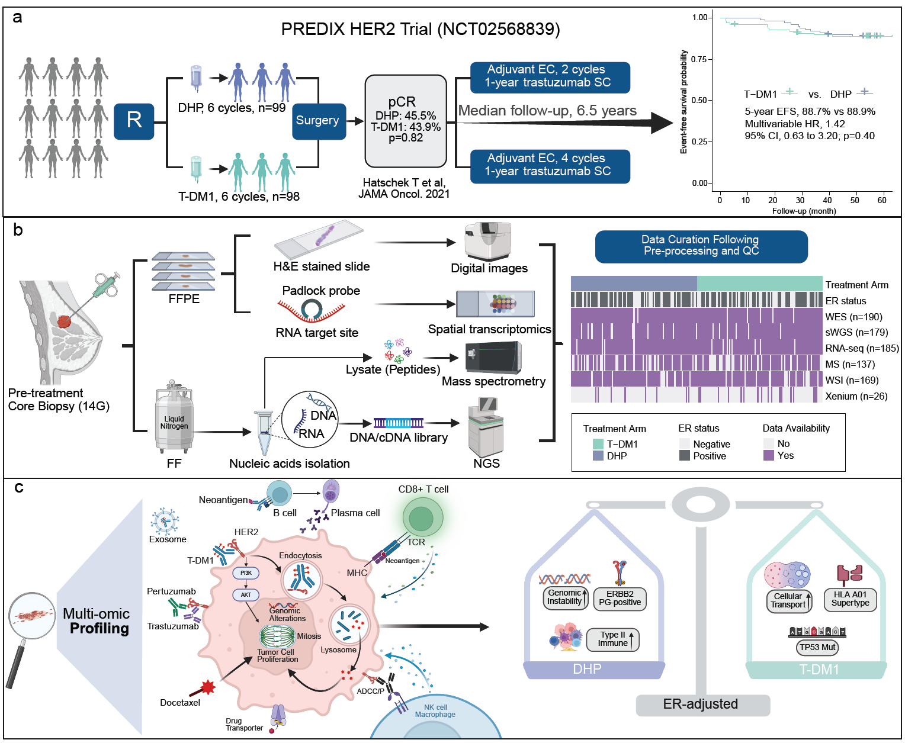
Multi-omic Profiling Reveals Predictive Biomarkers of Response to CT/ anti-body drug conjugates in HER2-Positive Breast Cancer – A randomized phase 2 study
Baseline
v2
v3
v4
Surgery
FU-1
FU-2
FU-3
FU-4
FU-5
Wang et al, unpublished data
Hatschek et al, JAMA Oncology, 2021

Slide 10
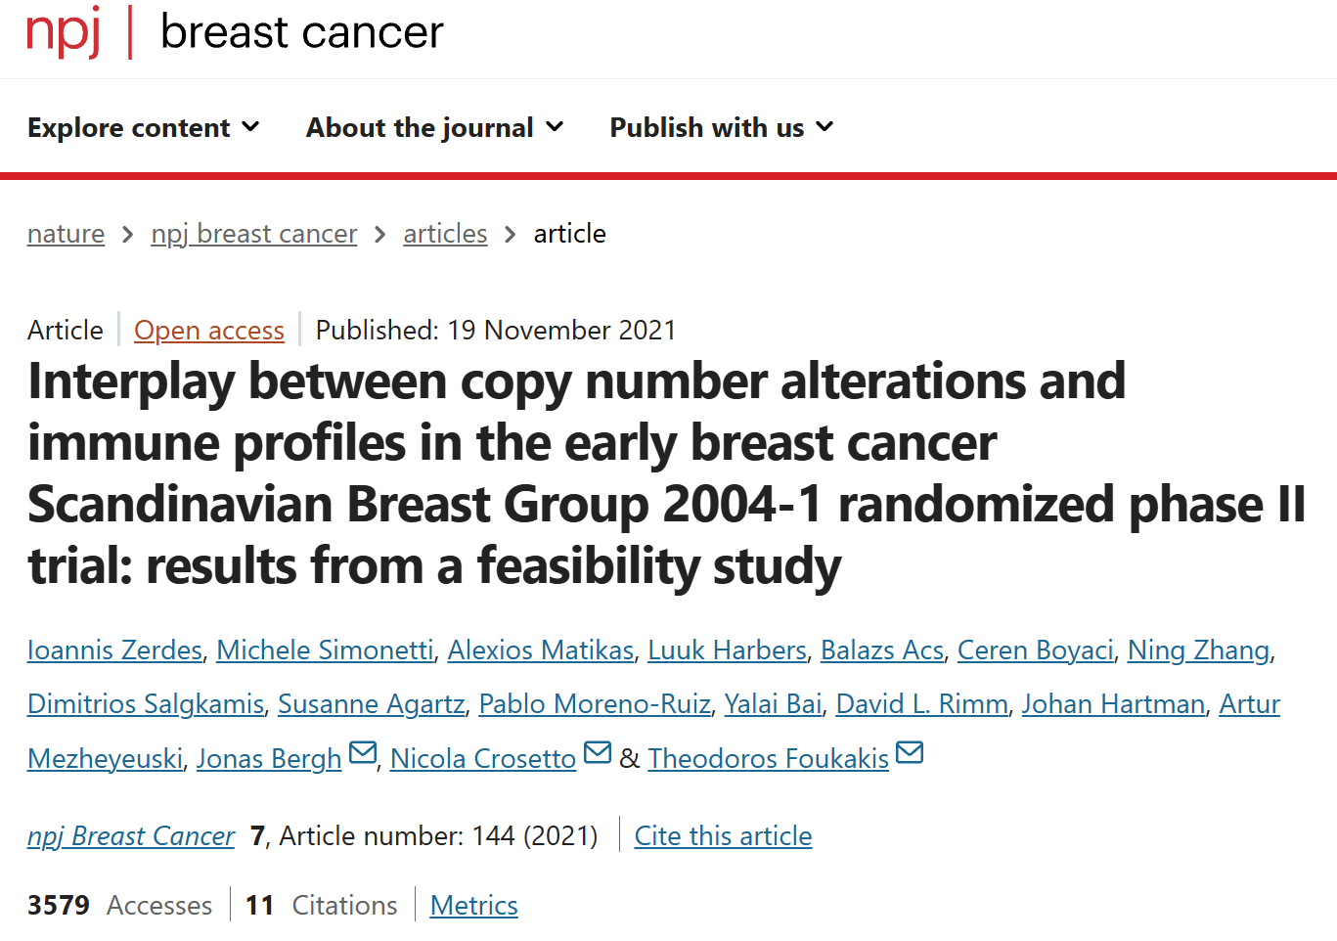
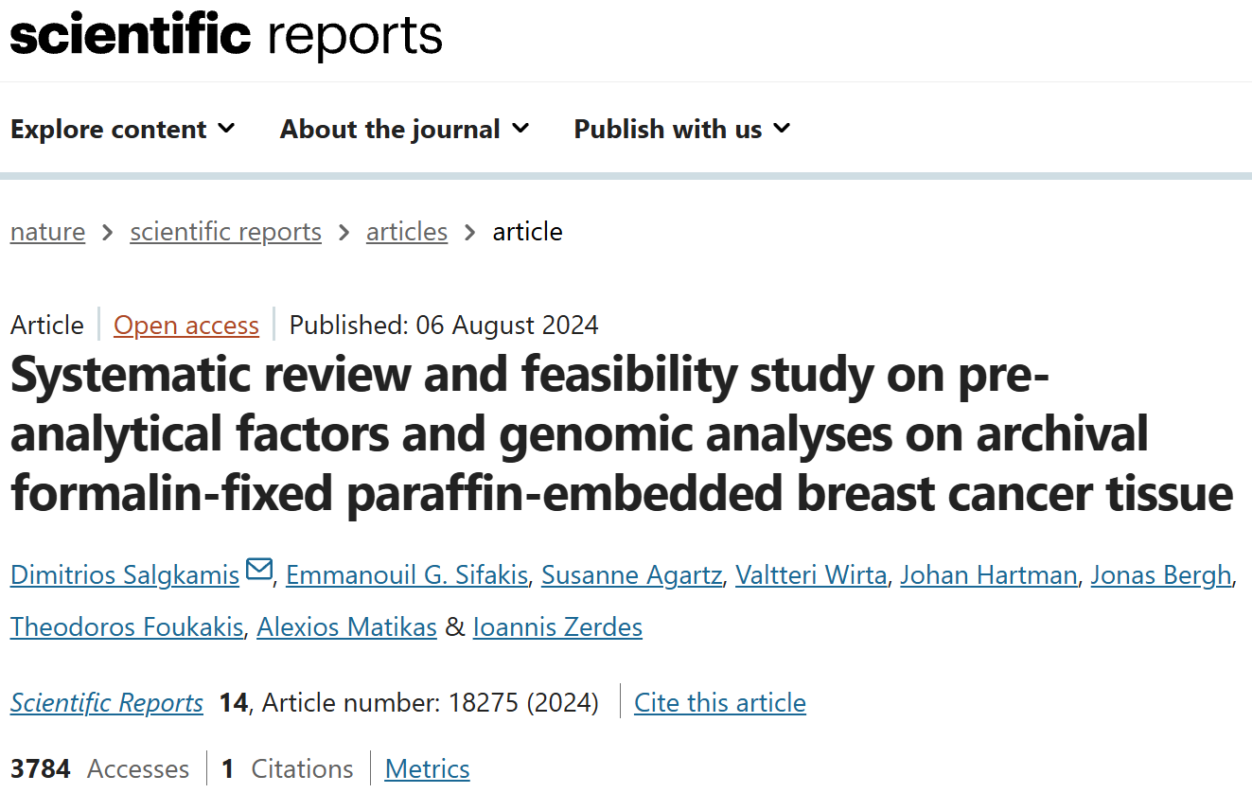
Publications (SBG2004-1 randomised phase II trial )

Slide 11
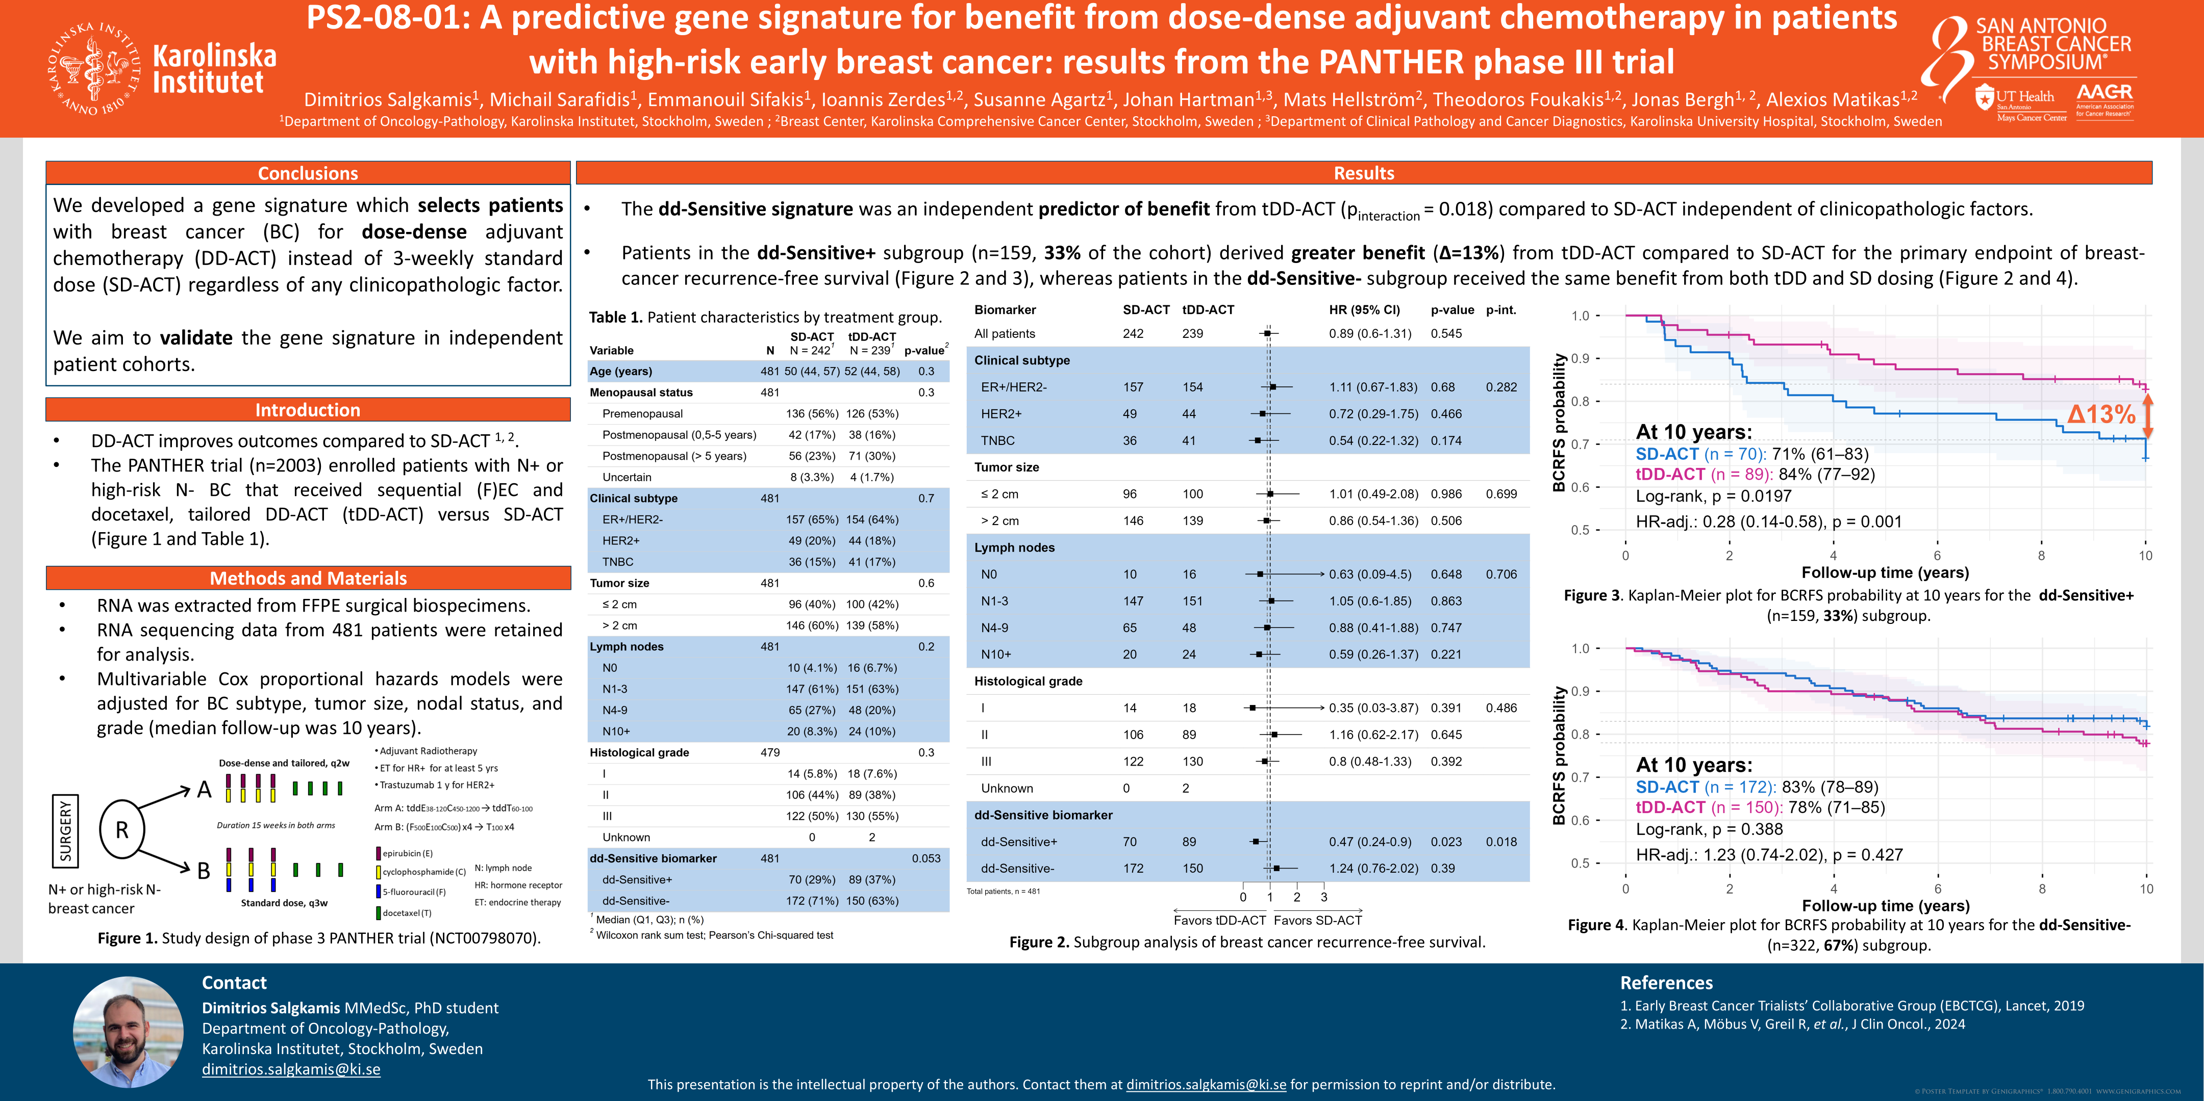
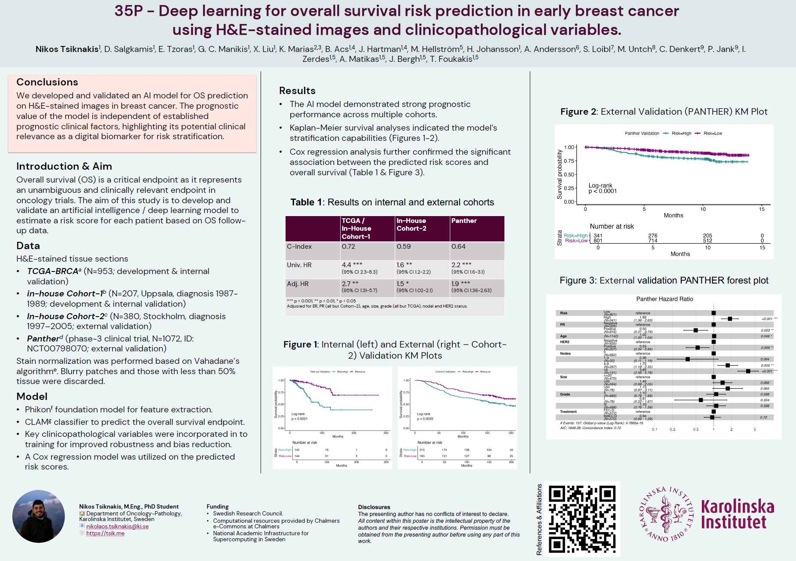
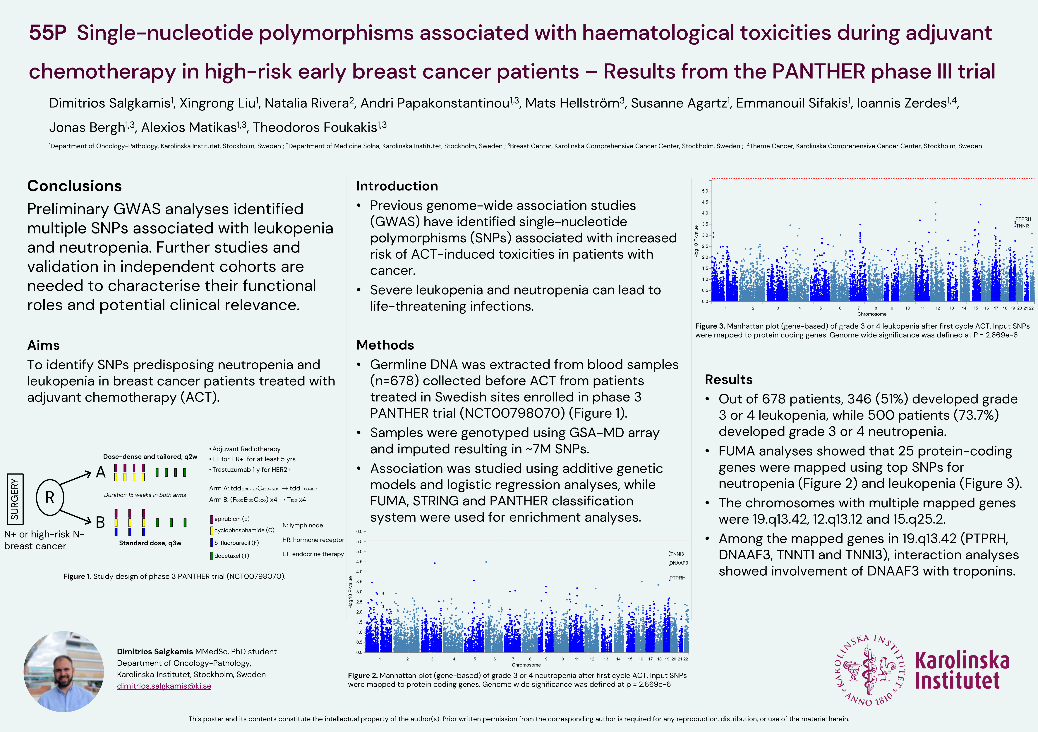
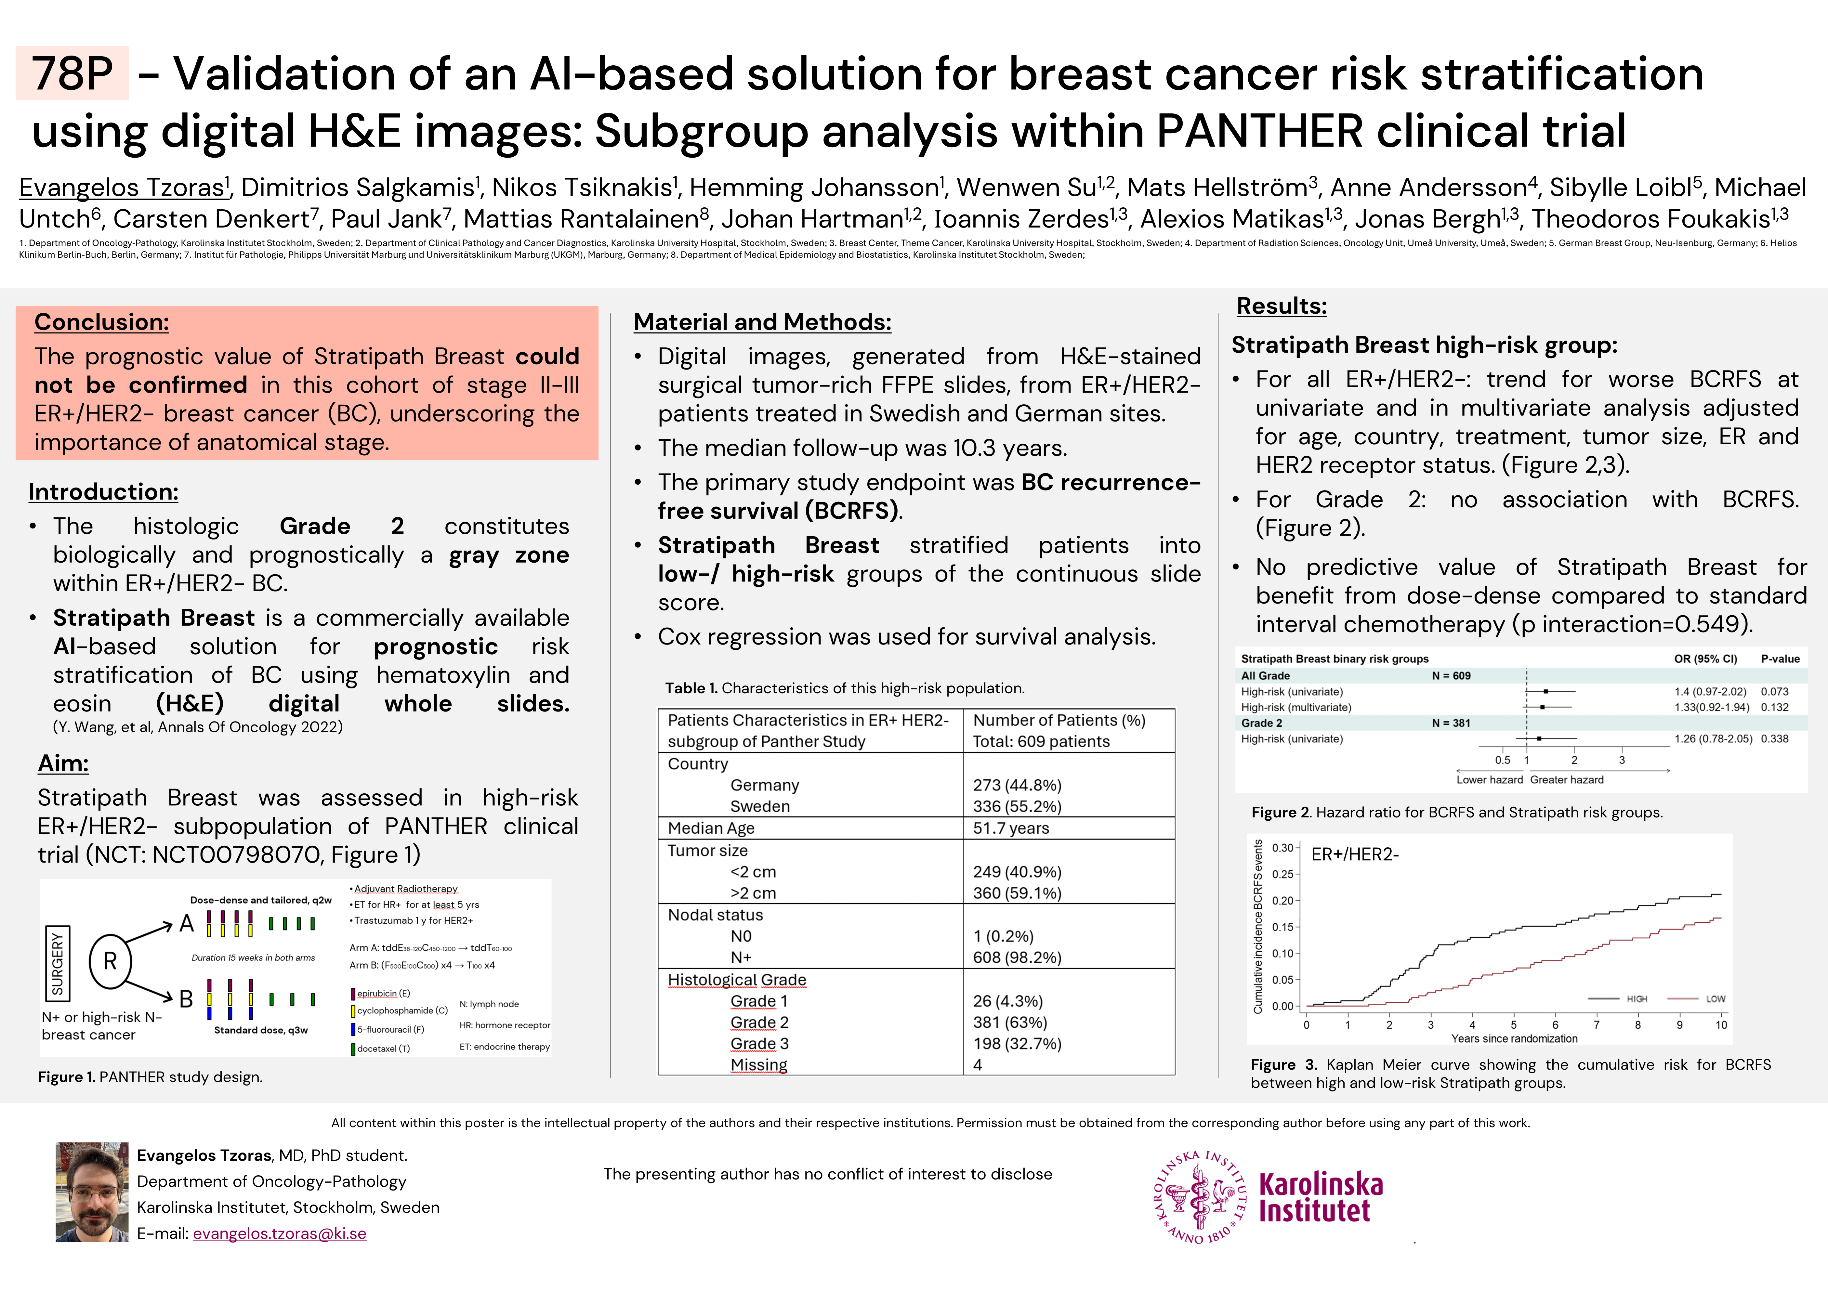
Posters 2025 (PANTHER phase III trial)

Slide 12
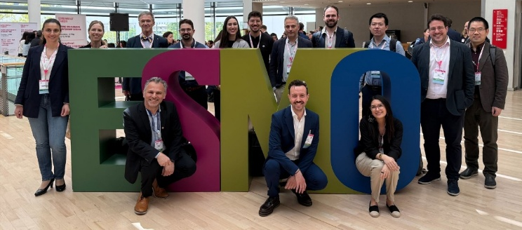
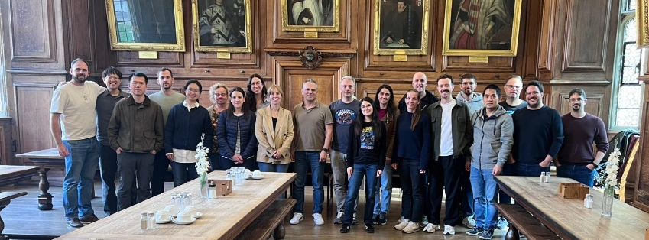
We are grateful to all the patients participating in the different prospective clinical studies, and the participants in our biobank effort at Karolinska.
Thank you for listening today at this EMA workshop

