Slide 1

Process Puzzle
Supervise a CT – Inspection record
CTIS Training Programme – Module 16
^{Version 1.1 – June 2021}
© European Medicines Agency, 2021
Reproduction and/or distribution of the content of these training materials for non-commercial or commercial purposes is authorised, provided the European Medicines Agency is acknowledged as the source of the materials.
The European Medicines Agency developed this training material to enhance public access to information on the Clinical Trial Information System (CTIS). This material describes a preliminary version of CTIS and may therefore not entirely describe the system as it is at the time of use of this material. The Agency does not warrant or accept any liability in relation to the use (in part or in whole) or the interpretation of the information contained in this training material by third parties.

Slide 2
Case scenarios process puzzle exercises
In this exercise we invite you to reflect on the steps you need to follow to complete and submit an Inspection report.
Flow of the activity
1
2
3
4
Master trainer explains the exercise and examples
Participants are divided in groups (if possible)
Participants organise their process puzzle case scenario
Group discussion of the outcome of the exercise

Slide 3
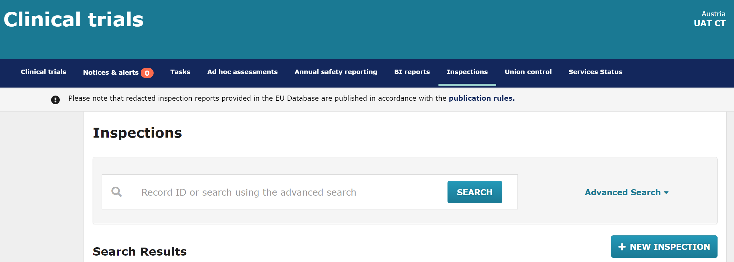
Example of a process puzzle
The example below visualises one way to create an inspection record. You will organize puzzle pieces following the same logic by dragging and dropping the figures to create a correct sequence of steps or actions.
Inspection tab
Login to CTIS
authority
workspace
Click on the ‘New inspection’ button
Open the Inspection tab to find a list of the RFIs received
Populate and submit the inspection
‘New inspection’ button
1
2
3
4

Slide 4
Order the pieces of the process puzzle
Case scenario 1
Carried-out inspection
A Member State Concerned has performed a routine inspection for a clinical trial performed in its territory. Drag and drop the pieces to show the sequence of steps that the Inspector should follow regarding this carried-out inspection record.
Populate
the Overall inspection outcome and reports
Populate the date and the inspection information
Upload the inspection report
Create an inspection entry
Create an inspection record
Populate
the General information section
Submit the
Inspection record
Drop here
Nº 1
Drop here
Nº 3
Drop here
Nº 5
Drop here
Nº 7
Solution:
Drop here
Nº 2
Drop here
Nº 4
Drop here
Nº 6

Slide 5
Order the pieces of the process puzzle
Case scenario 2
Inspection triggered by a notification
A sponsor has submitted a notification of a Temporary Halt of a clinical trial. The Member State Concerned of the clinical trial decides to do an inspection in the future (planned inspection) to determine if the conduct of the clinical trial is in line with the CT Regulation, Drag and drop the pieces to show the sequence of steps that the Inspector should follow to create and submit an inspection triggered by a notification.
Add an inspection entry
Create the inspection record
Select ‘Triggered’ in the General information section
Access the Overall inspection outcome and reports
Access the Inspection section
Access the General information section
Perform the inspection
Select the notification that triggered the Inspection
Submit the planned inspection record
Submit the inspection report
Drop here
Nº 1
Drop here
Nº 3
Drop here
Nº 5
Drop here
Nº 7
Drop here
Nº 9
Solution:
Drop here
Nº 2
Drop here
Nº 4
Drop here
Nº 6
Drop here
Nº 8
Drop here
Nº 10

Slide 6
Order the pieces of the process puzzle
Solution
Case scenario 1
Carried-out inspection
A Member State Concern has performed a routine inspection for a clinical trial performed in its territory. Drag and drop the pieces to show the sequence of steps that the Inspector should follow regarding this carried-out inspection record.
Create an inspection record
Create an inspection entry
Populate
the Overall inspection outcome and reports
Submit the
Inspection record
Solution:
Populate the General information section
Populate the date and the inspection information
Upload the inspection report

Slide 7
Order the pieces of the process puzzle
Solution
Case scenario 2
Inspection triggered by a notification
A sponsor has submitted a notification of a Temporary Halt of a clinical trial. The Member State Concerned of the clinical trial decides to do an inspection in the future (planned inspection) to determine if the conduct of the clinical trial is in line with the CT Regulation, Drag and drop the pieces to show the sequence of steps that the Inspector should follow to create and submit an inspection triggered by a notification.
Create the inspection record
Select ‘Triggered’ in the General information section
Access Inspection section
Submit the planned inspection record
Access
the Overall inspection outcome and reports
section
Solution:
Access the General information section
Add an inspection entry
Select the notification that triggered the inspection
Perform the inspection
Submit the inspection report

